Slide 1
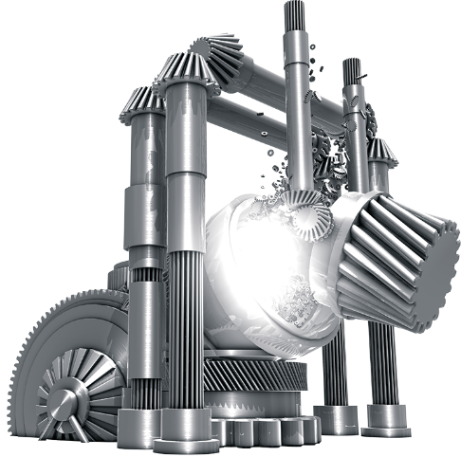
The metals industry driven by David Brown

Slide 2
Revision Control
Revision | Section | Page | Description | Date | Up-issued by
A | Initial Issue |  | Initial Issue | 23/8/2012 | MH

Slide 3













Market reference for the Metals Industry World Wide

Slide 4
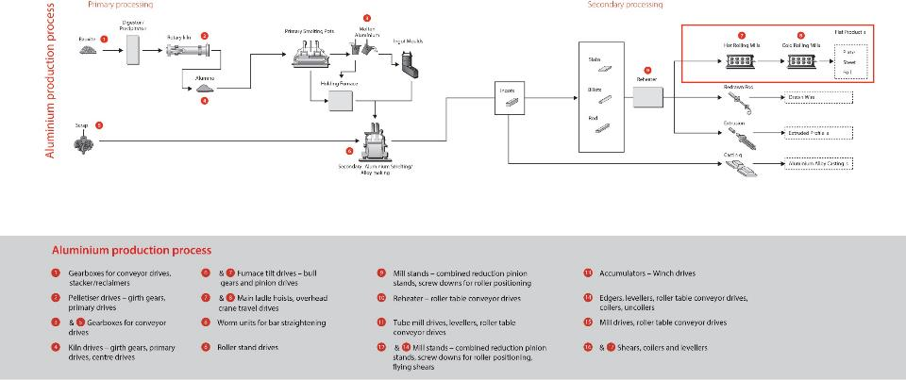
Key Products – Aluminium

Slide 5
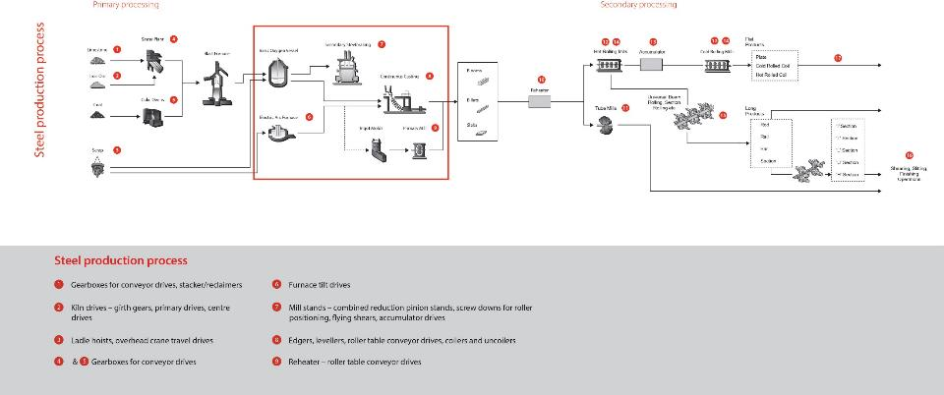
Key Products – Steel

Slide 6
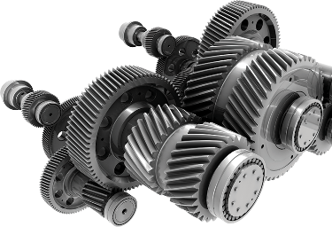
Services offered
Project studies by our project department
Rapid solution proposals
Validation of specifications
Manufacture
Complete Project management
Assistance during installation and commissioning
Aftermarket support during the long life of the gearbox
Specific solutions according to your specifications

Slide 7
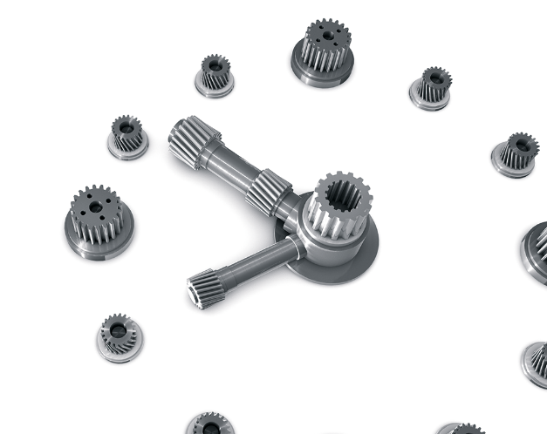
Gearboxes throughout their Life Cycle
6- Assistance with
installation and
commissioning
7- Parts Replacement
In situ or in our
works
5- Optimisation of
your equipment
4- Repair and
Maintenance
3- Manufacture in our own
workshop and with our
supply chain partners
2- Specific Solutions
according to your
requirements
1- Analysis of project. and Diagnostics

Slide 8
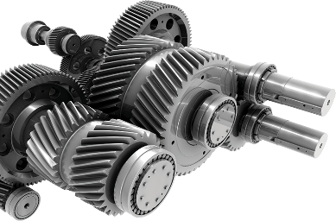
Management of your Existing Equipment
Expertise on site
Diagnostic testing in the workshop
Repair and refurbishment
Reconditioning
Improving reliability of equipment
Audit and plan maintenance
Turnkey Service
All types and all makes, not just David Brown
Responsibility and Reactivity
Workshop technicians throughout the world with the support of our global technical resources. Global support delivered locally.

Slide 9
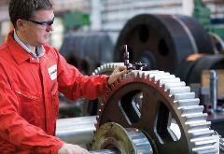
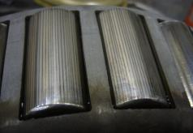
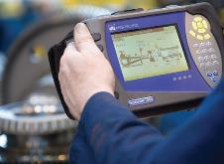
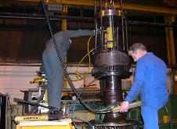
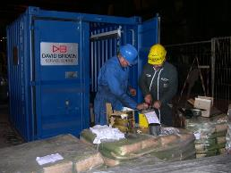
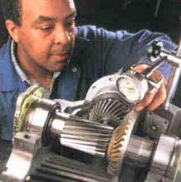
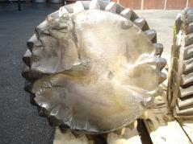
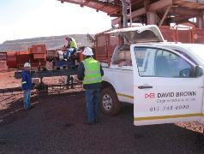
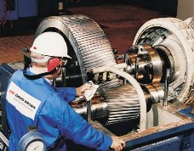
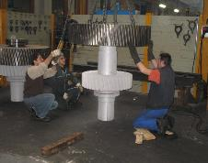
Service support
SERVICE & REPAIR EXPERTISE IN HOUSE OR IN SITU

Slide 10
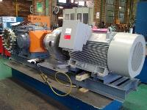
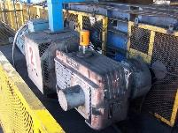
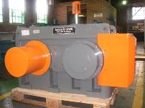
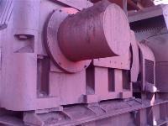
Conveyor Drives
A base plated shaft mounted conveyor unit power pack, with a David Brown South Africa Series L Gear unit
A bell housing shaft mounted series L conveyor power pack
A DB Series L gear unit, Left- as manufactured,
Right- in operation under the harsh conditions of
an iron ore mine

Slide 11
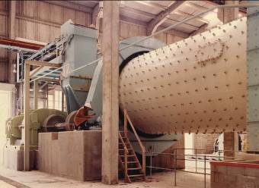
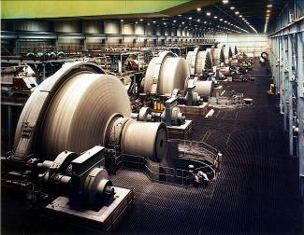
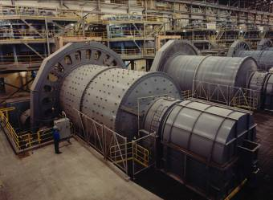
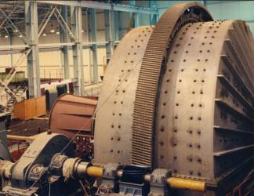
Raw Material Crushing & Grinding

Slide 12
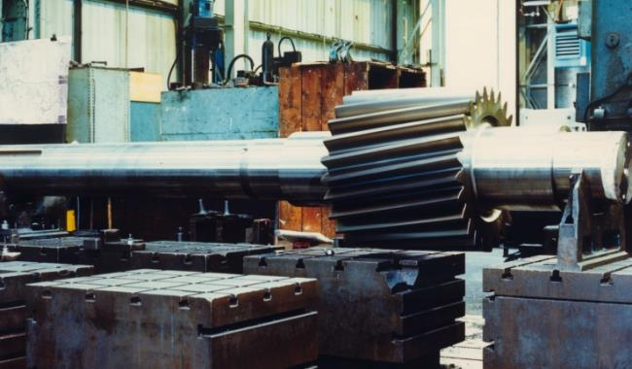
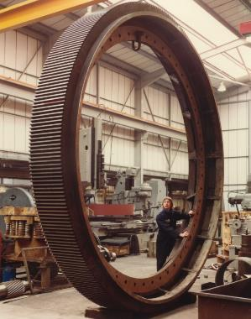
Girth Gears and Pinions for Material Crushing & Grinding Mills
David Brown has capacity to manufacture gears up to 14m diameter for ball mill applications, and to supply associated mill drives and pinions

Slide 13
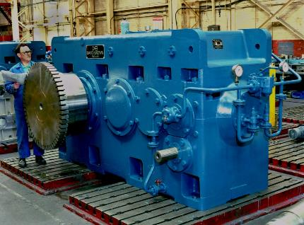
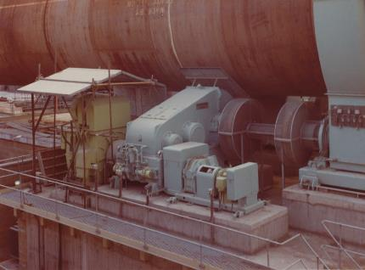
Kiln Drives
Kiln drive for Tianjin Pipe Company, China
David Brown can supply complete packages for kiln drives, including the primary drive, barring drive, pinions and girth gears.

Slide 14
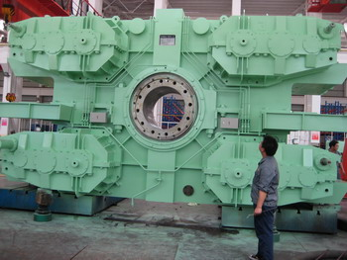
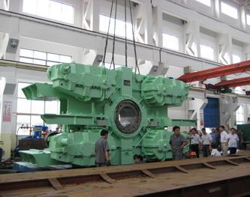
Converter and Furnace Tilt Drives
Converter Tilt drive supplied to Tangshan Stainless - China

Slide 15
Converter and Furnace Tilt Drives
Furnace Tilt Drive for New Zealand Steel
Output Torque 2000 kNm

Slide 16
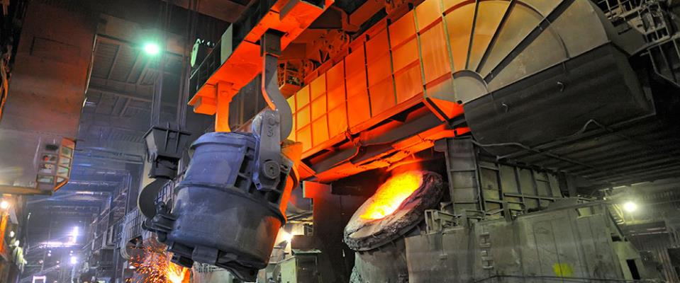
Converter and Furnace Tilt Drives
Furnace Tilt Drive for Tata Steel Scunthorpe works 24”x36”x48” TRGU
Driving BOS Vessel Bull Wheel (Weight 40000 kg)

Slide 17
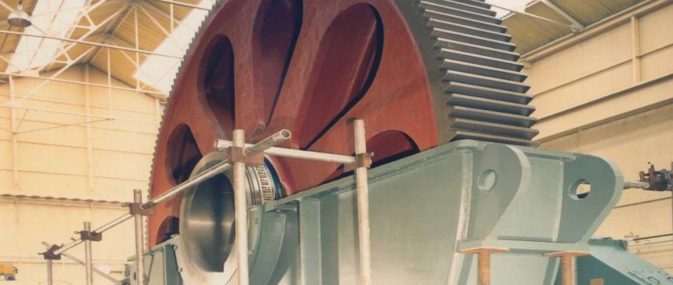
Converter and Furnace Tilt Drives
Detail of Bull Wheel for Furnace Tilt Drive for Tata Steel Scunthorpe Works

Slide 18
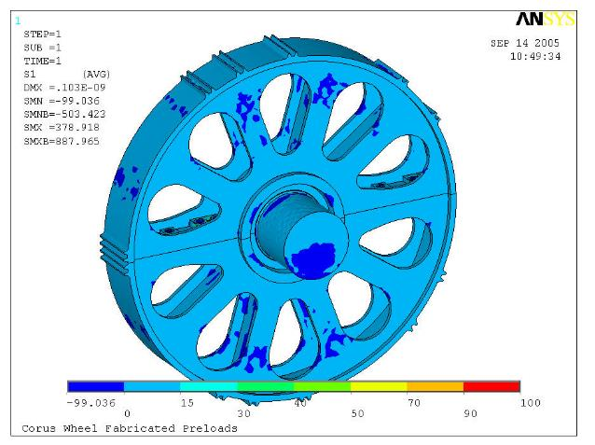
Converter and Furnace Tilt Drives
Furnace Tilt Drive Bull Wheel & Pinions
  Bull Wheel designed as a fabrication rather than a casting with full F.E.A.
  Bull Pinions Case Hardened & Profile ground.(DB Standard)

Slide 19
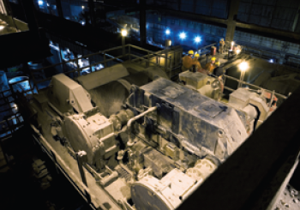
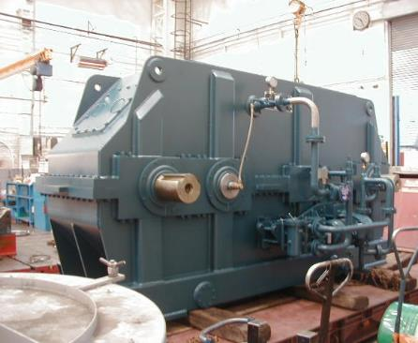
Main Hoist Drives
Twin input hoist differential unit for 500Tonne ladle Hoist – Tata Steel Scunthorpe works

Slide 20
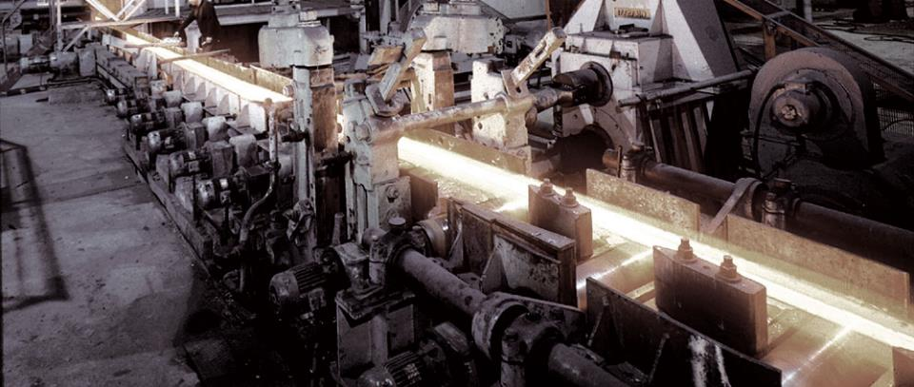
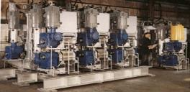
Continuous Casting Machines
Worm gear driven Continuous Casting machine String Guides

Slide 21
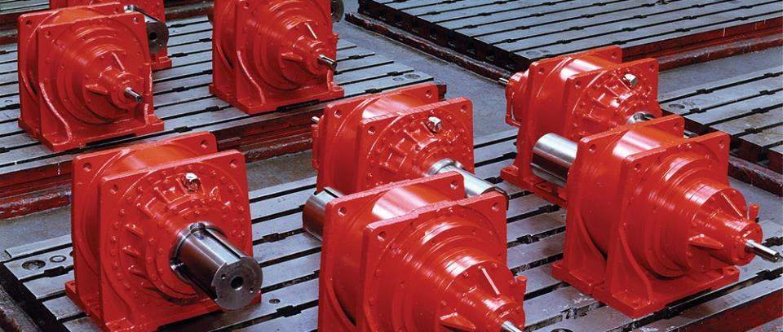
Continuous Casting Machines
Planetary Roller Table Drives for Continuous Casting machines for Tata Steel
Notes:
The red gear units are standard four stage co - axial planetary type for use on a Continuous Casting machine at British Steel.
The blue gear units are combined two stage helical reduction gears with five roll leveller gears, currently working on Columbus Joint Venture South Africa.
Further examples >>> NEXT SLIDE

Slide 22
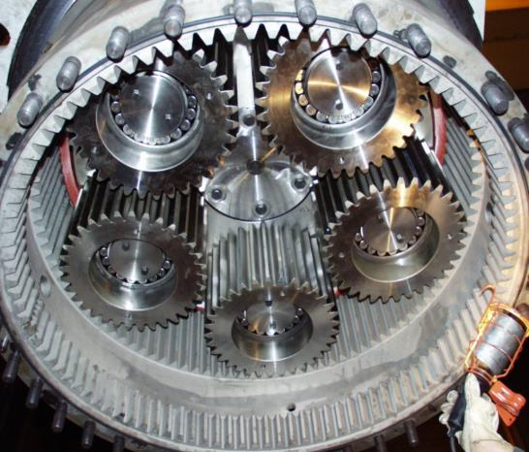
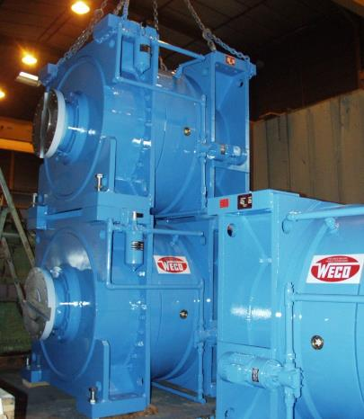
Planetary aluminium continuous caster drive units for Novelis France
Continuous Casting Machines (Aluminium)

Slide 23
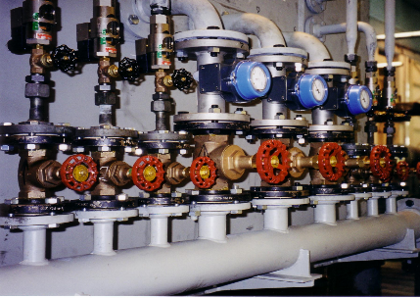
Roughing Mill Drives
Customer Arcelor Mittal France
140 tonne 15MW Rolling Mill Drive

Slide 24
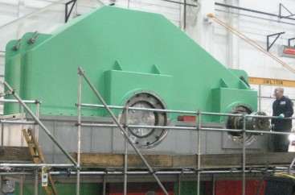
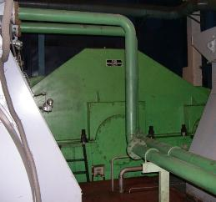
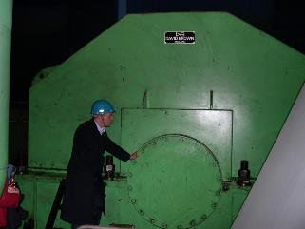
Replacement F1 Hot Mill drive for Meishan Steel (Bao Steel) China
Hot Mill Drives

Slide 25
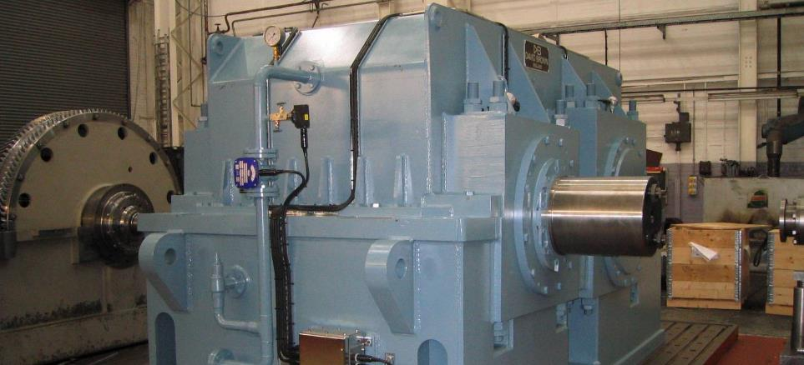
Hot Mill Drives
Main Hot Mill reducer – Jindal Steel India

Slide 26
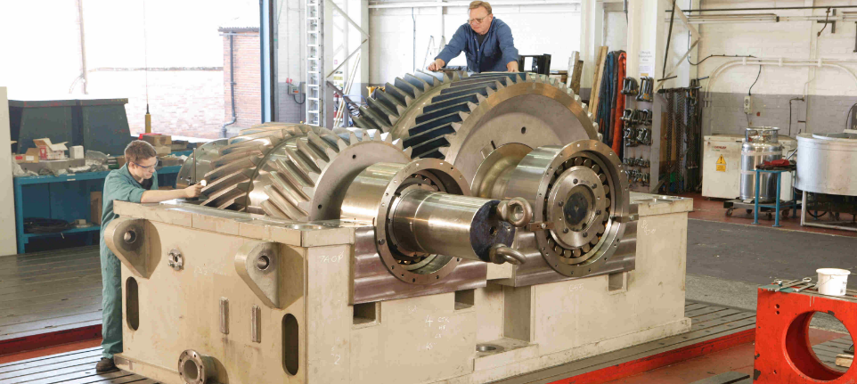
Hot Mill Drives
Main reducer for pinion stand unit – internal view

Slide 27
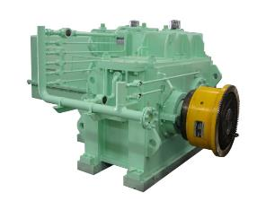
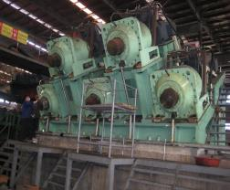
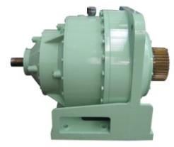
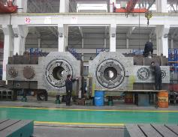

Hot Rolling Mill Drives
  F1 main reducer
Planetary Reducer for sizing mill
vertical roll for hot rolling
F1 vertical roll reducer
for hot rolling

Slide 28

Cold Mill Drives
Rolling Mill Drive for Plate Mill for Egyptian Iron and Steel

Slide 29


Cold Mill Drives
Supplied to Tata Steel (UK) – a 5 stand cold rolling mill upgrade programme using multiple DB single reduction helical gearboxes

Slide 30

Pinion stands
Two High Pinion Stand for Seamless Tube Pilger Mill Drive (Tata Steel)

Slide 31

Pinionstand for Bridgnorth Aluminium UK
Pinion stands

Slide 32

Pinion stands
Pinion stand unit – Jindal Steel India

Slide 33

Pinion stands

Slide 34

Combined Reduction Pinion stands
Three output shaft reducer / pinion stand for small roughing mill for Titanium roughing mill for Timet UK

Slide 35
Combined Reduction Pinion stands

Slide 36

An Steel China Cold rolling mills, DB Engineers assisting with installation
Combined Reduction Pinion stands

Slide 37



Combined Reduction Pinion stands
Wuhan Steel China Cold Foil Mill number 4, S1 to S5

Slide 38



Wuhan Steel China Cold Foil Mill number 4 on site
Combined Reduction Pinion stands

Slide 39


Combined Reduction Pinion stands

Slide 40




Combined Reduction Pinion stands
Small worm gear driven mill stands

Slide 41

Independent Roll Pinion stands
Twin input pinion stand drop in replacement unit for Hindalco India

Slide 42

Combined Reduction Pinion Stand Gear Unit for Hindalco, India
Combined Reduction
Pinion Stand Gear Unit
Designed to AGMA 6005 B89
Weight 65000 kg
‘Drop In’ Replacement Gear Unit
Two previous units (not DB supply!) have previously failed
Actual SF 6.2+
Motor Power 2 x 800 Kw
Motor Speed 0/590/1200 rpm
Output Speed 0/31/63.1 rpm
Reduction Ratio 19:1

Slide 43


Combined Reduction Pinion Stand Gear Unit for Hindalco, India
Original gear unit
Note: The tight space constraints
The new unit ready for despatch

Slide 44

Twin input /twin output pinion stand drive for Laiwu Steel China, supplied to First Heavy Machinery
Independent Roll Pinion stands

Slide 45


Independent Roll Pinion stands
Timet unit – 100 tonnes
Twin drive to replace existing unit in Titanium rolling
Twin drives each 750kW at 14rpm, Nominal Torque = 512kNm per shaft

Slide 46
Rolling Mill Pinions
Pinions to 1.5 m dia & .8 m Face
Notes:
Mill Pinions can be cut to
3 metres diameter (10 feet)
1 metre face width ( 43 inch)
5 metres shaft length (17 feet)

Slide 47

Rolling Mill Pinions

Slide 48


Rolling Mill Pinions

Slide 49



Screwdown Stands on 80 inch Hot Strip Mill at Great Lakes Steel
David Coates/ The Detroit News
Notes:
The 80 hot strip mill screwdown stands at National Steel’s Great Lakes Division in Ecorse, Michigan. Cone Drive HO120-1&2 12.000 inch C.D. 10:1 ratio primary gearboxes drive special Cone Drive 24.000 inch C.D., 50:1 ratio gearsets which drive 18.000 inch diameter acme screws to adjust (50-60 times/sec) the distance between reduction rolls to precisely control the steel sheet’s gauge (thickness) while it is traveling at more than 50 miles per hour.

Slide 50

Roll Screw Down Drives

Slide 51






Ancillary Mill drives - Edgers, Shears, Coilers, Levelers
11 roller straightener
for roll changing
for sizing
flying shear
for coiler
for straightener

Slide 52


Leveller Drives

Slide 53


13 output leveller
Leveller Drives

Slide 54


Leveller Drives
9 output leveller

Slide 55
Leveller Drives
5 output Leveller Units
Notes:
The red gear units are standard four stage co - axial planetary type for use on a Continuous Casting machine at British Steel.
The blue gear units are combined two stage helical reduction gears with five roll leveller gears, currently working on Columbus Joint Venture South Africa.
Further examples >>> NEXT SLIDE

Slide 56

Leveller Drives
24 output Leveller Unit for China
Notes:
The red gear units are standard four stage co - axial planetary type for use on a Continuous Casting machine at British Steel.
The blue gear units are combined two stage helical reduction gears with five roll leveller gears, currently working on Columbus Joint Venture South Africa.
Further examples >>> NEXT SLIDE

Slide 57

Coilers / Uncoilers
Hollow Shaft Coiler Unit Bronx Engineering

Slide 58


Coiler Units with integral mandrells for Novelis France
Coilers / Uncoilers

Slide 59


Coiler Unit with integral mandrell for Dolgarrog Aluminium UK
Coilers / Uncoilers

Slide 60

Flying Sheer for Hot Mill in China
Shear Units

Slide 61

Vertical Edger for Xiangtan Steel China
Edger Drives

Slide 62


Transfer Drives
TPCO China - Transfer Gearbox Installation
TPCO China - Transfer Gearbox Installation

Slide 63

Tube Mill Drives
Seamless Tube Mill Drive
Tata Steel UK

Slide 64



Tube Mill Drives
Extractor Mill Gearbox for Seamless Tube PQF Mill Tianjin Pipe Company (TPCO) China

Slide 65



Tube Mill Drives
TPCO – Extractor Mill Installation

Slide 66


Tube Mill Drives
Piercing Mill Gearbox for PQF Mill Tianjin Pipe Company

Slide 67



Tube Mill Drives
TPCO – Piercing Mill Installation

Slide 68

Tube Mill Drives
TPCO – Sizing Mill Installation

Slide 69

Rod Mill Drives
High Speed
Rod Mill
Kishiwada
Steel Japan

Slide 70

Replacement Gearing
Upgraded Gears for combined reduction and pinion stand unit.
Hewlett’s Aluminium Pietermaritsburg South Africa

Slide 71



Refurbishment
Refurbishment of main hoist drive for Arcelor Mittal France

Slide 72



Refurbishment
Repair of 3 damaged coiler drives or Bohai Aluminium China, after fire damage
1st 2 Gearboxes repaired in 3 weeks
After
Before

Slide 73


Refurbishment
Repair and refurbishment of 28.5 tonne Danieli mill drive gearbox for One Steel Australia

Slide 74


Roll forming

Slide 75

Thank you for your time and attention!
Notes:
THANK YOU

